Slide 1


Prediction Modeling Loan Risk
Data Scienctist - ID/X Partners
Presented by
Wika Rabila Putri

Slide 2


Wika Rabila Putri
rabilaputri@gmail.com
https://www.linkedin.com/in/wika-rabila-putri/
Bandung, Indonesia
Fresh graduate with a keen interest in data and finance. Armed with hands-on experience in SQL, Python, Excel, and data visualization from rigorous projects and a specialized bootcamp, Wika excels at turning complex data into actionable insights. With a solid foundation in financial management and a strong drive for data-driven decision-making, Wika is eager to contribute to a forward-thinking team as a Business Analyst. Her goal is to leverage her analytical skills and passion for data to help optimize business strategies and drive impactful results.

Slide 3
Project Portfolio
A financing company is aiming to enhance the precision of its credit risk assessment and management processes. The goal is to optimize loan approval decisions and mitigate financial losses resulting from defaults. To achieve this, we are developing a sophisticated machine learning model that leverages data from both approved and rejected loans.
The machine learning model will analyze historical loan data to predict credit risk with greater accuracy. By incorporating a comprehensive dataset, which includes detailed information on both successful and unsuccessful loan applications, the model is designed to identify patterns and signals indicative of high-risk borrowers.
Project explanation video: Click here!
Code: Click here! (GitHub)

Slide 4

About Company
Established in 2002 by former bankers and management consultants with extensive experience in credit lifecycle management, score development, and performance management, ID/X Partners has a robust track record in serving corporations across Asia and Australia. Company expertise spans various industries, including financial services, telecommunications, manufacturing, and retail.
ID/X Partners specializes in consulting services that leverage data analytics and decision-making solutions (DAD), combined with integrated risk management and marketing disciplines. Company goal is to help clients optimize portfolio profitability and business processes.
Company comprehensive consulting services and technology solutions position ID/X Partners as a leading provider of integrated services, committed to delivering impactful results for clients.

Slide 5

Table of Content
Business Understanding
Data Understanding
Exploratory Data Analysis
Data Preparation
Data Modeling
Evaluation
Conclusion

Slide 6
Business Understanding

Slide 7

Current Problem.
The client, a lending company (multifinance), faces significant challenges in accurately assessing and managing credit risk, leading to:
1.
Financial Losses Due to Defaults: The existing credit evaluation process may result in approving loans to high-risk borrowers.
Limited Growth Opportunities: Potentially creditworthy applicants might be rejected, restricting business growth.
Inefficiency in Credit Assessment: Current manual or heuristic-based approaches are inadequate to handle the complexity and volume of credit applications.
2.
3.
Impact:
High default rates result in substantial financial losses.
Suboptimal credit approval decisions negatively affect business performance.

Slide 8


Needs.
Improve the accuracy of credit risk assessment.
Minimize default rates.
Optimize loan approval decisions.
Enhance overall profitability.

Slide 9
Data Understanding

Slide 10
Data Overview.
1.
The dataset provided consists of 466,285 entries and 75 columns
2.
The dataset consists of 53 numerical columns and 22 categorical columns
3.
There are 40 columns with missing (null) data in the dataset
4.
No duplicate data
Imbalanced Columns: pymnt_plan is identified as imbalanced with one category having a very high count compared to the other.
High Cardinality Columns: Columns with a large number of unique values.
Emp_title, url, desc, title, zip_code
Low Cardinality Columns: Columns with a with relatively few unique values.
term, pymnt_plan, initial_list_status, application_type
Unnecessary columns: The column that will not be included in the model.
Unnamed, id, member_id, collections_12_mths_ex_med

Slide 11
Exploratory Data Analysis

Slide 12
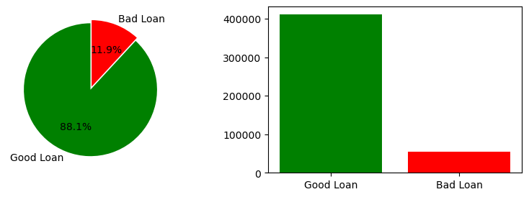
Loan Classification
Financial Overview
Good Loans: 88.13%
Loans are current, fully paid, or in a grace period.
Indicates strong performance and minimal risk.
Bad Loans: 11.87%
Includes loans that are charged off or defaulted.
Represents a significant financial risk.
Total Profit: Approx. 5.87 billion
Demonstrates significant revenue generation from the loan portfolio.
Total Loss: Approx. 790.79 million
Primarily attributed to bad loans.
Highlights the financial risk and impact of bad loans.
Notes:
Terdapat 2 klasifikasi pinjaman: Pinjaman Baik: 88,13% Pinjaman yang saat ini dalam keadaan baik, telah dilunasi, atau dalam masa tenggang. Menunjukkan kinerja yang kuat dan risiko minimal.
Pinjaman Buruk: 11,87% Termasuk pinjaman yang sudah dihapus atau gagal bayar. Mewakili risiko finansial yang signifikan.
Lalu, ringkasan keuangannya, terdapat: Total Profit: Sekitar 5,87 miliar Menunjukkan pendapatan yang signifikan dari portofolio pinjaman.
Total Kerugian: Sekitar 790,79 juta Terutama disebabkan oleh pinjaman buruk. Menyoroti risiko finansial dan dampak dari pinjaman buruk.

Slide 13
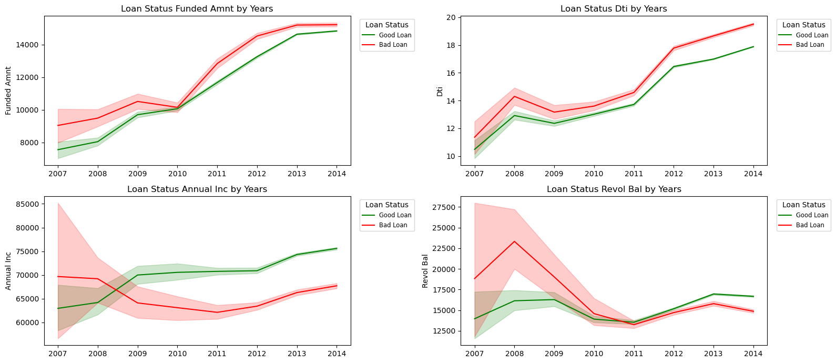
Analysis by Loan Year
Notes:
Analisis berdasarkan pinjaman tahunan
1. Funded Amount by Loan Status (in Years), pada grafik ini memiliki Volume pinjaman meningkat setiap tahun, bad loans lebih banyak daripada good loans secara keseluruhan.
2. Debt-to-Income (DTI) by Loan Status (in Years), pada grafik ini menunjukkan tren yang tidak stabil.
3. Annual Income by Loan Status (in Years), pada grafik ini good loans memiliki pendapatan tahunan yang lebih rendah dibandingkanbad loans pada awalnya, namun setelah itu meningkat secara stabil.
4. Revolving Balance by Loan Status (in Years), pada grafik ini menunjukkan Penurunan saldo revolving pada 2008 berkorelasi dengan penurunan pendapatan tahunan dan Debt to Income.

Slide 14
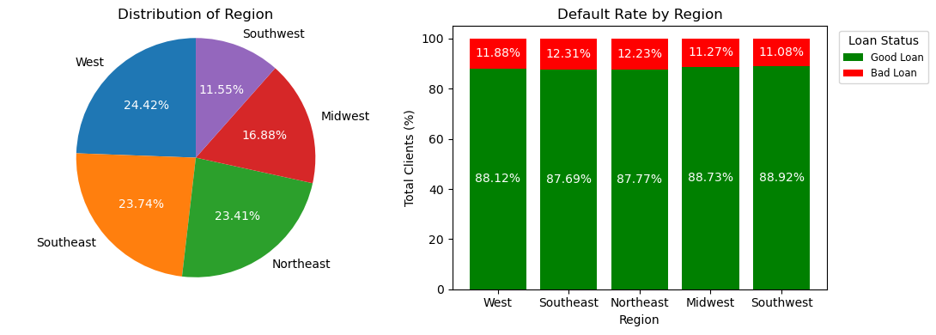
Analysis by Region
Good Loans: Across all regions, a high percentage of loans are classified as Good Loans, consistently around 87% to 89%.
Stable Performance: This consistency suggests relatively stable loan performance nationwide.

Slide 15
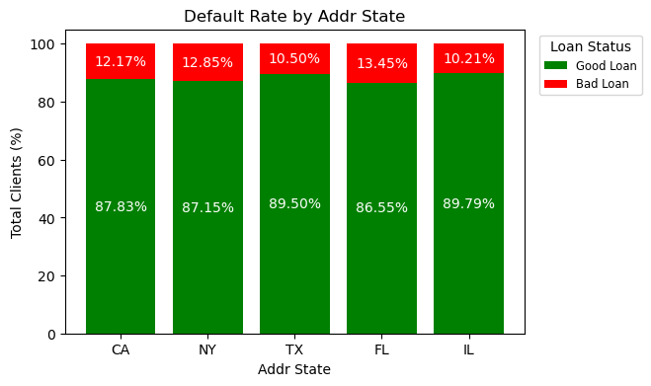
Analysis by State

Slide 16
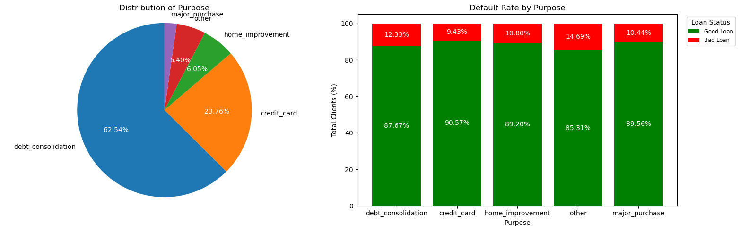
Analysis by Loan Purpose

Slide 17
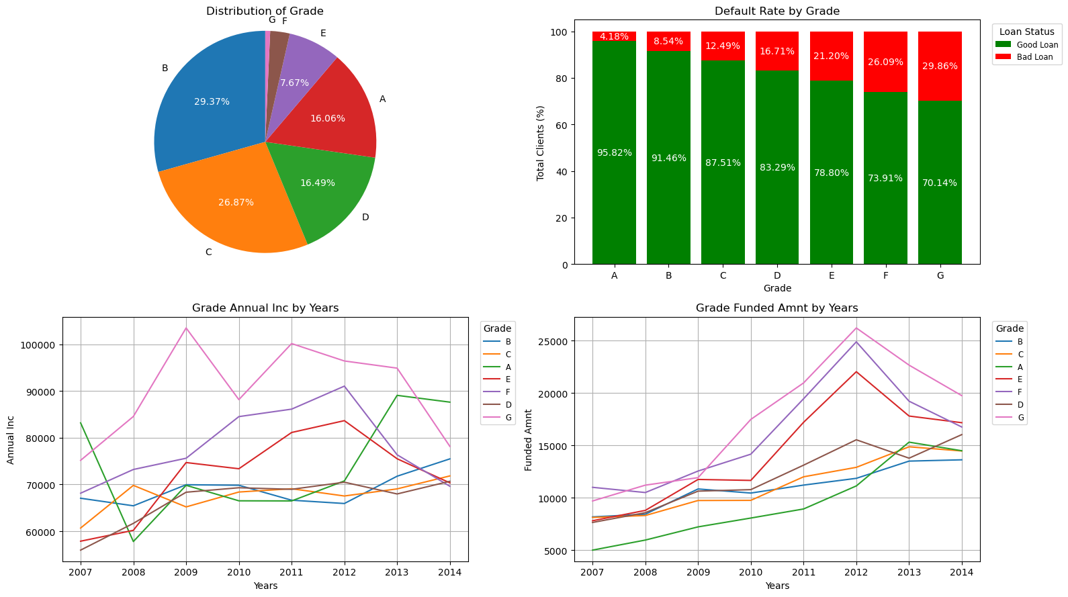
Analysis by Loan Grade

Slide 18
Data Preparation.
Feature Creation
SMOTE
Drop Column
With more than 40% missing values, High Cardinality, Low Variance, Multicollinearity, Unnecessary columns
Impute Column
With less than 40% missing values, Numerical: median, Categorical: mode
Feature Selection
Chi square test, ANOVA test, Multicollinearity, Cap Outliers
Feature Engineering
Encoding, Scaling, SMOTE

Slide 19
Data Modeling

Slide 20
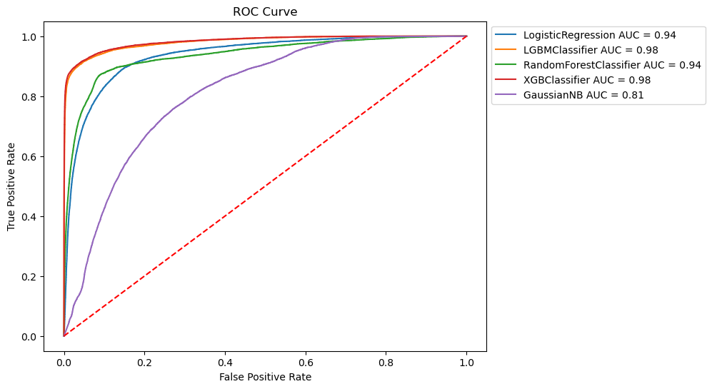
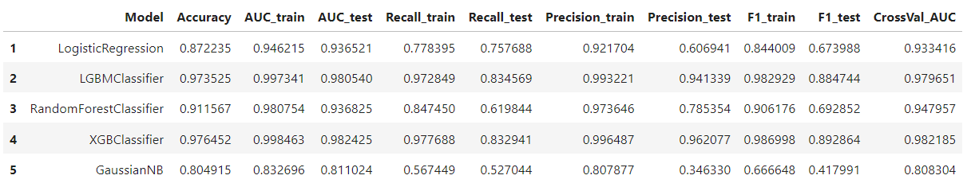

Slide 21
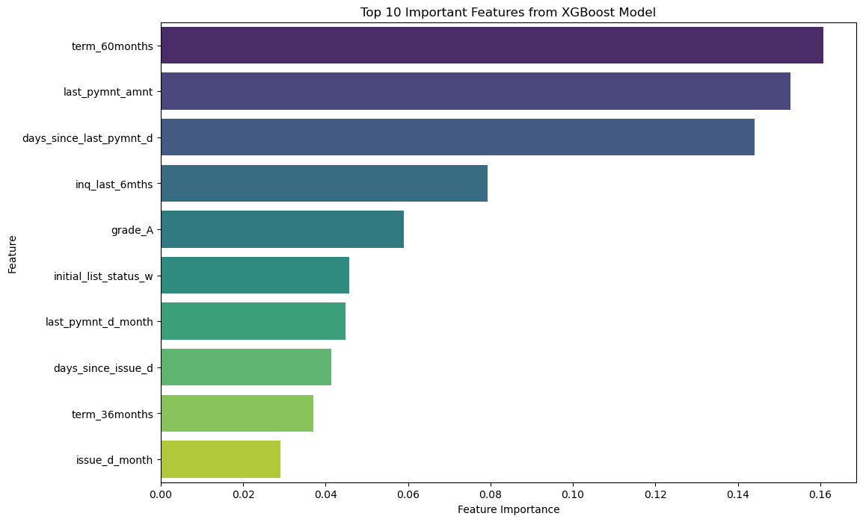

Slide 22
Evaluation

Slide 23
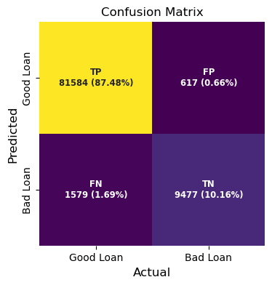
Model Evaluation.

Slide 24
Model Evaluation.
Significant Reduction in Bad Loans Total Bad Loans Before: 55,332 Total Bad Loans After: 10,980 Decrease in Bad Loans: -44,352 Default Rate Before: 11.9% Default Rate After: 2.4% Decrease in Default Rate: -9.5% | Increased Revenue Total Revenue Before: $5,873,258,515 Total Revenue After: $6,507,128,475 Increase in Revenue: $633 million | Reduction in Default Losses Total Default Loss Amount Before: $790,793,935 Total Default Loss Amount After: $156,923,975 Decrease in Default Losses: -$633 million | Net Revenue Boost Net Revenue Before: $5,082,464,579 Net Revenue After: $6,350,204,499 Increase in Net Revenue: $1.27 billion

Slide 25
Conclusion

Slide 26

Conclucions.
Ideal Model: XGBClassifier
Outstanding Model Performance:
High Accuracy: XGBClassifier excels at identifying good loans with impressive accuracy.
Significant Reduction in Bad Loans: Bad loans decreased drastically from 55,332 to 10,980.
Decrease in Default Rate: Default rate fell from 11.9% to 2.4%.
Financial Improvement:
Increased Total Revenue: Total revenue rose by approximately $633 million.
Reduction in Default Losses: Default losses decreased by over $633 million.
Net Revenue Boost: Net revenue increased by $1.27 billion.
Risk Management and Profitability:
Effective Risk Mitigation: The model significantly reduces credit and default risk.
Enhanced Profitability: Implementation of this model boosts the company's profitability potential.

Slide 27
Thank You

